Slide 1

Industrial IoT Data Science with H2O
Jo-fai (Joe) Chow
Data Scientist
joe@h2o.ai
@matlabulous
H2O Hands-on Workshop
La Fosse Associates
27th & 28th September, 2016

Slide 2
About Me: Civil Engineer → Data Scientist
2005 - 2015
Water Engineer
Consultant for Utilities
EngD Research
Machine learning + Water Engineering
Discovered H2O in 2014!
2015 - Present
Data Scientist
Virgin Media (UK)
Domino Data Lab (US)
H2O.ai (US)
Why? Long story – see bit.ly/joe_h2o_talk2

Slide 3
Agenda
Workshop #1
About H2O
Data Munging in H2O
Case 1 (Basics)
Classification
Importing data
Exploring data
Training models
Evaluating models
Tuning models (manual)
Workshop #2
Case 1 (Advanced)
Early stopping
Tuning models (auto)
Stacking models
Saving/loading models
Case 2
Anomaly detection
Other H2O features

Slide 4
About H2O

Slide 5
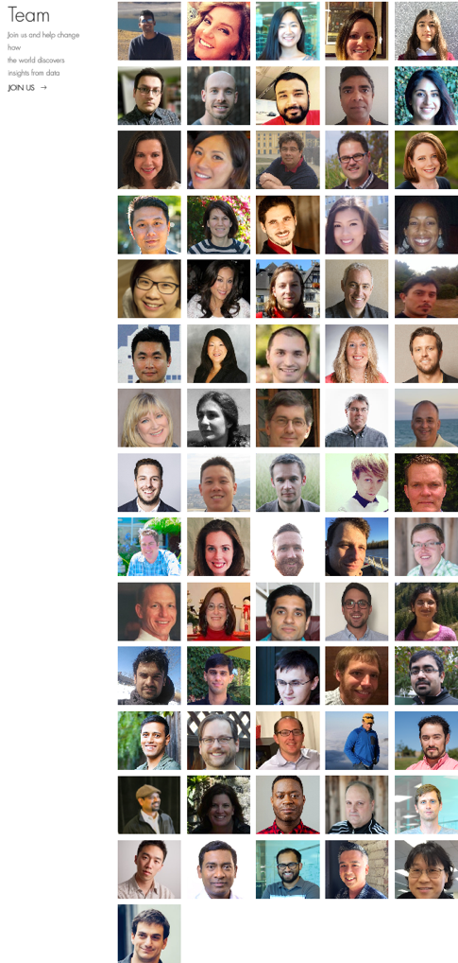
About H2O.ai
H2O.ai, the Company
Team: 80 (71 shown)
Founded in 2012,
HQ: Mountain View, California
H2O, the Platform
Open Source (Apache 2.0)
R, Python, Scala, Java and Web Interfaces
Distributed Algorithms that Scale to Big Data
Works with Laptop, Cloud, Hadoop & Spark
Joe
Notes:
Team is growing rapidly
Based in Mountain View – I am the only guy in UK/Europe
VC: $34M in total

Slide 6







H2O Platform Overview
Core algorithms written in high performance Java.
Fast, distributed and scalable.
APIs available in R, Python, Scala, REST/JSON and web.
Works with laptop, cloud, Hadoop and Spark

Slide 7
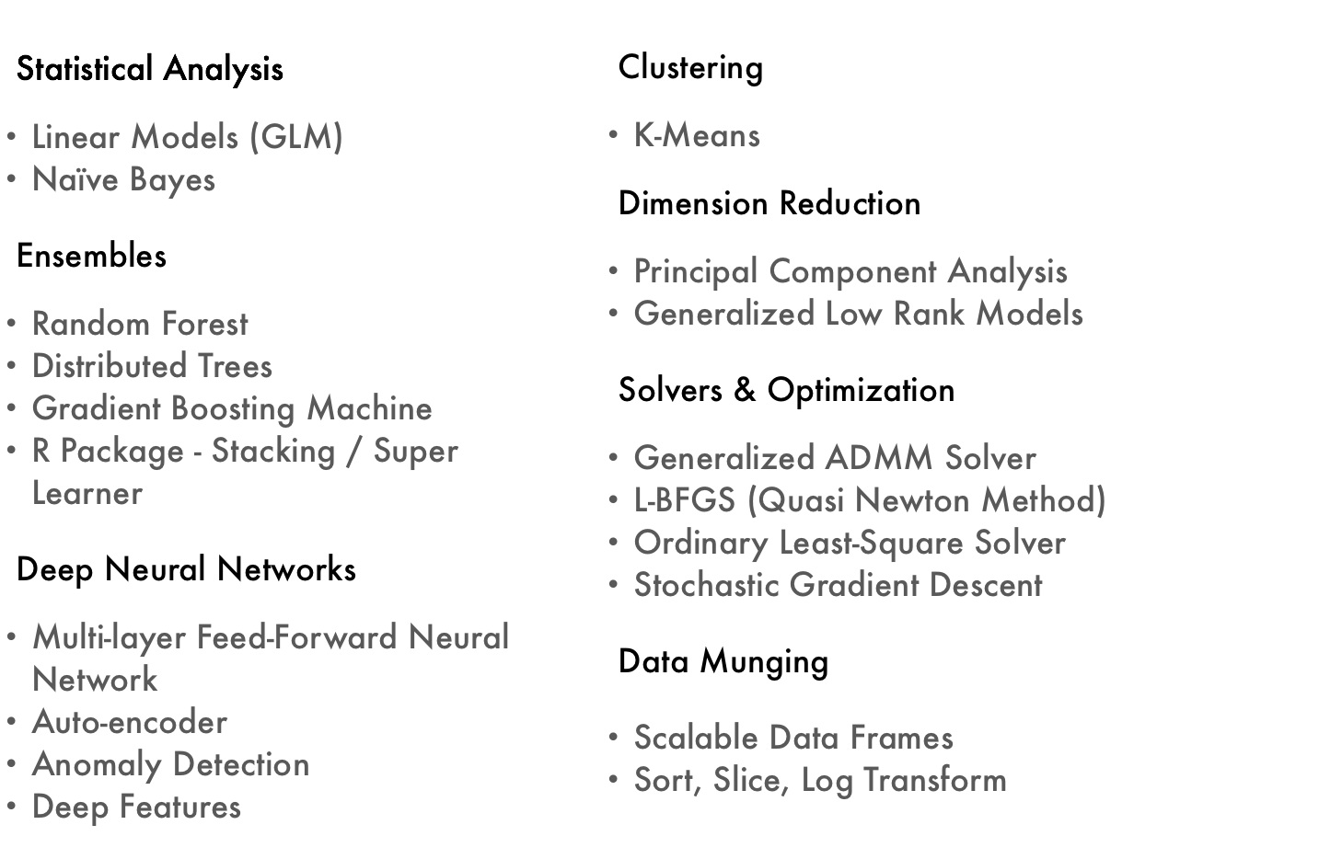
Current Algorithm Overview
Joe’s Strata Hadoop
London Talk
bit.ly/joe_h2o_talk4
Workshop
Joe’s LondonR Talk
bit.ly/joe_h2o_talk3

Slide 8

H2O Overview
8

Slide 9
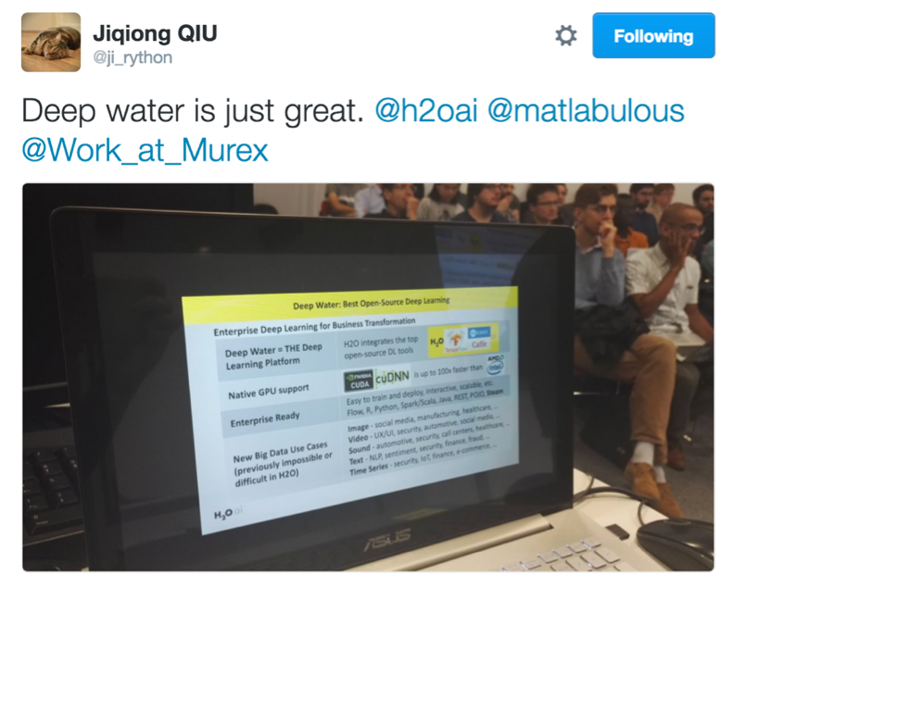
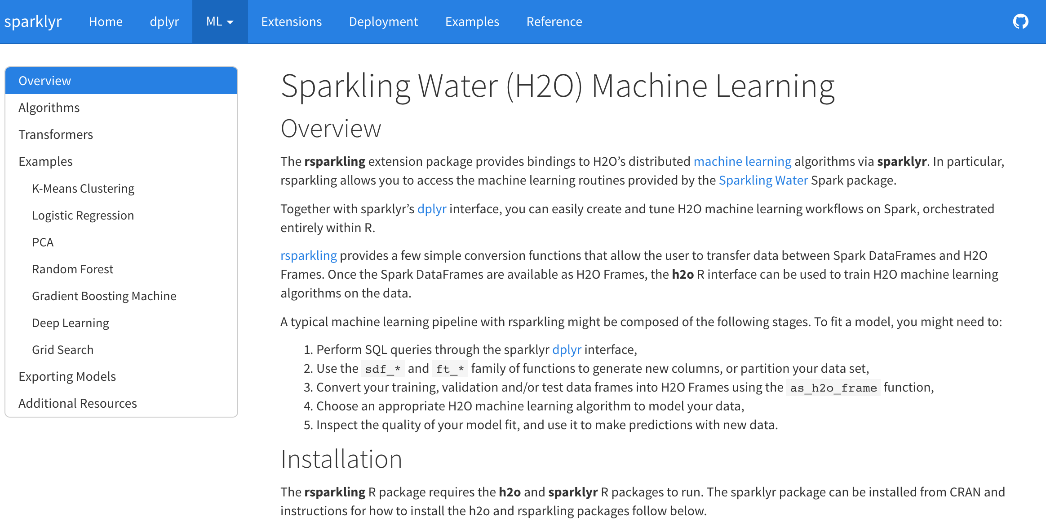
New Stuff!
H2O + RStudio
RSparkling
Deep Water: Next-Gen Deep Learning in H2O

Slide 10
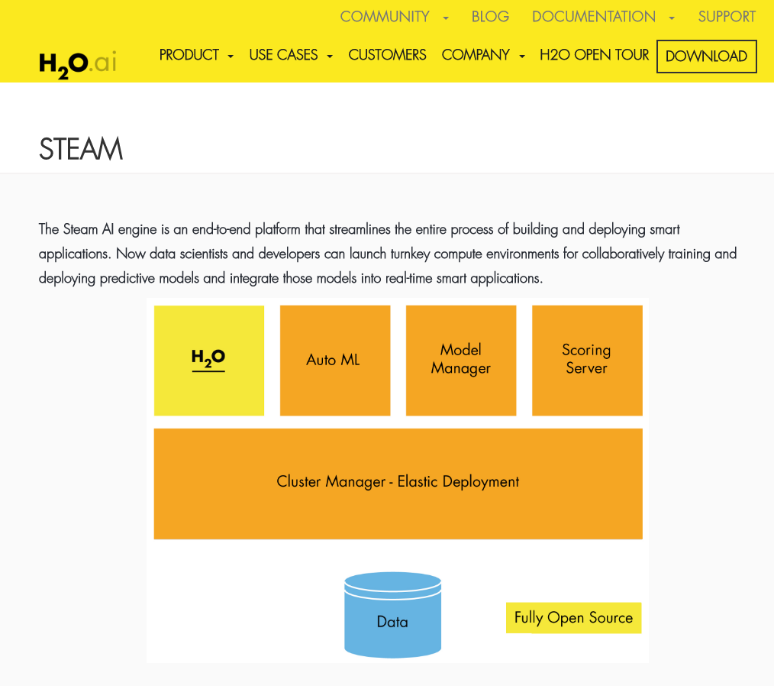
New Stuff!

Slide 11
Data Munging in H2O
by Jan Gorecki & Matt Dowle
(see pdf in repo)

Slide 12
Workshop #1
Use Case 1: Classification

Slide 13
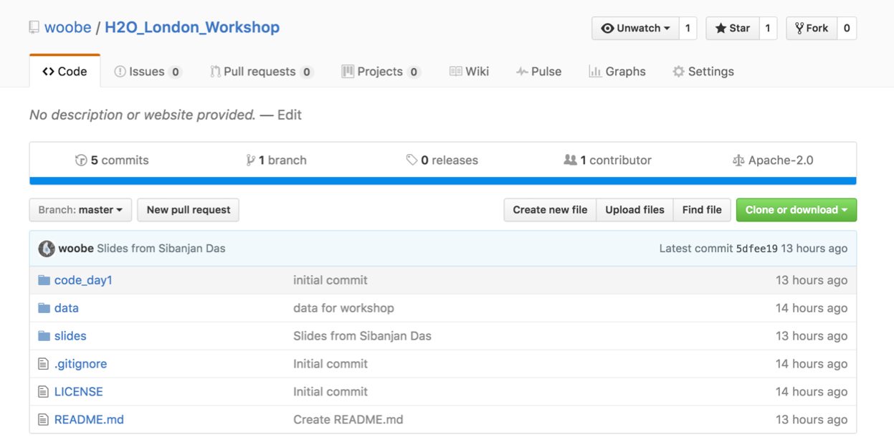
Download Data & Code for Workshop
Please go to bit.ly/h2o_iot_workshop1

Slide 14
Workshop #1
Use Case 1: Classification
Step 1: R Packages

Slide 15
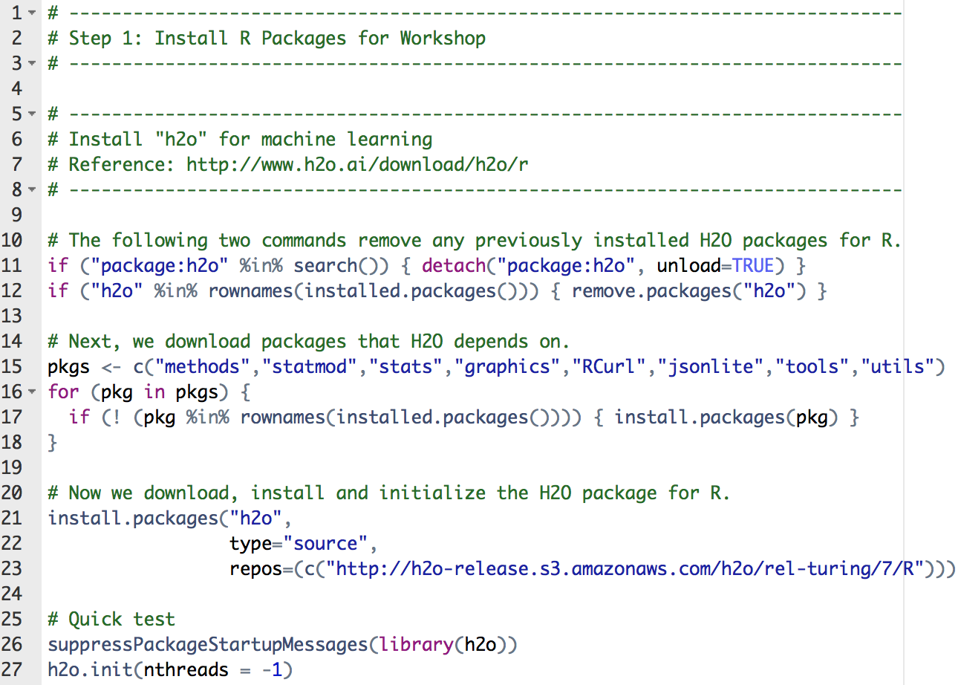
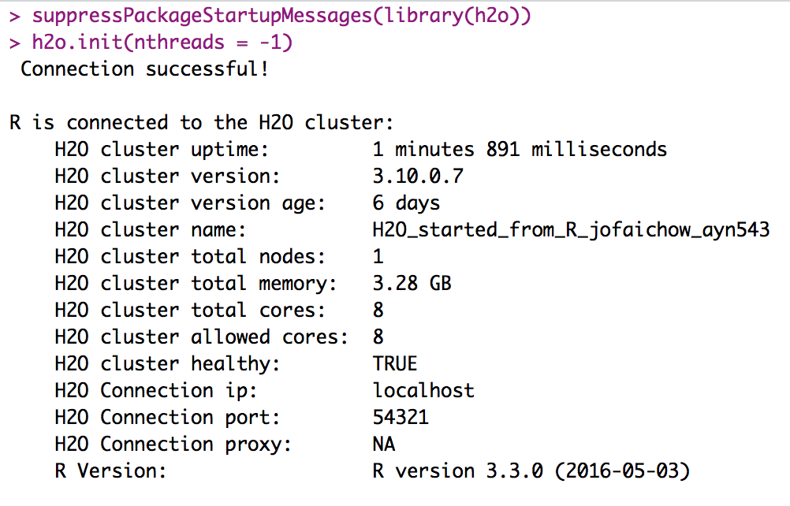
step_01_install_packages.R
Package ‘h2o’

Slide 16
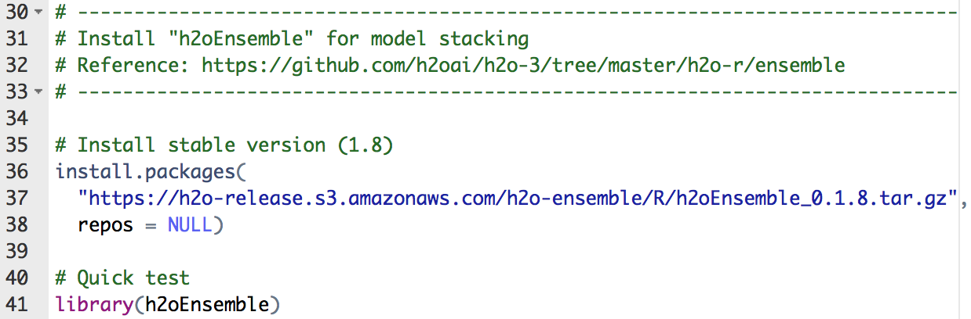
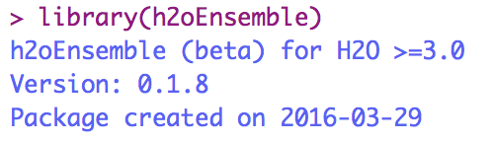
step_01_install_packages.R
Package ‘h2oEnsemble’

Slide 17
Workshop #1
Use Case 1: Classification
Step 2: Exploratory Analysis

Slide 18
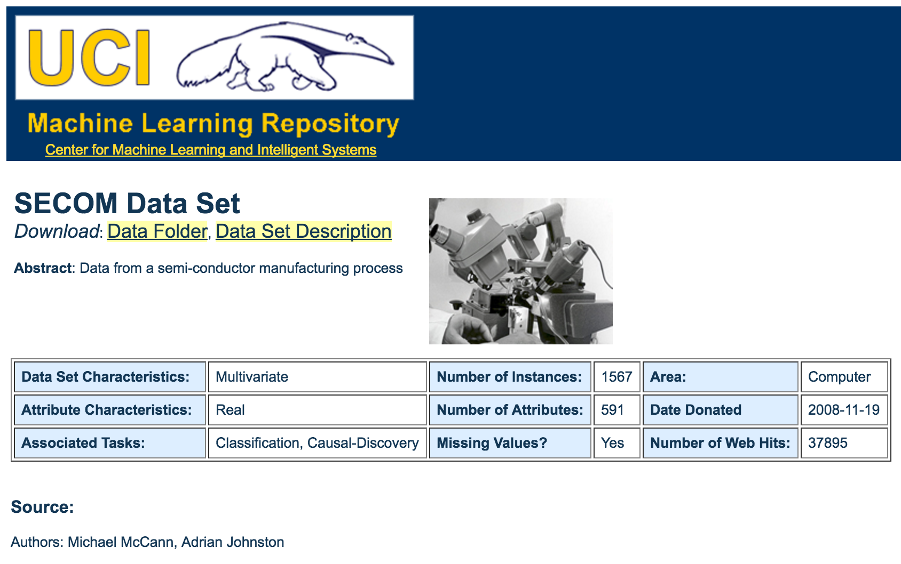
Data for Use Case 1: SECOM

Slide 19
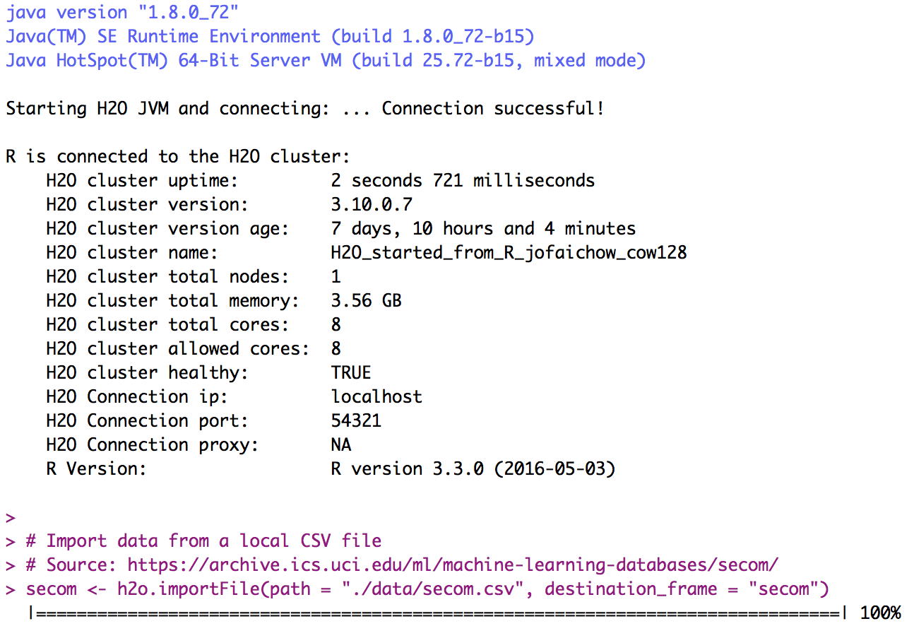
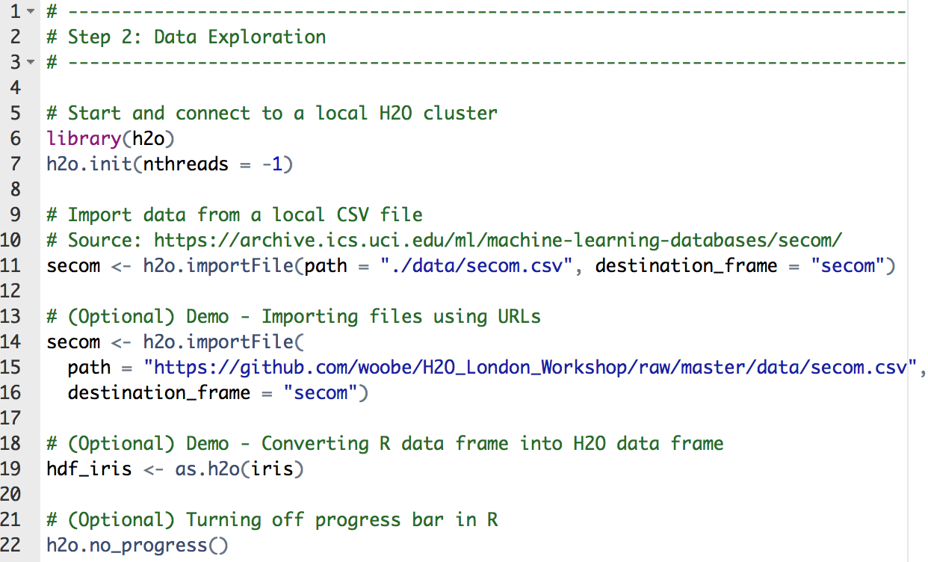
step_02_exploratory_analysis.R
Importing SECOM data
Optional (different ways to import data)

Slide 20
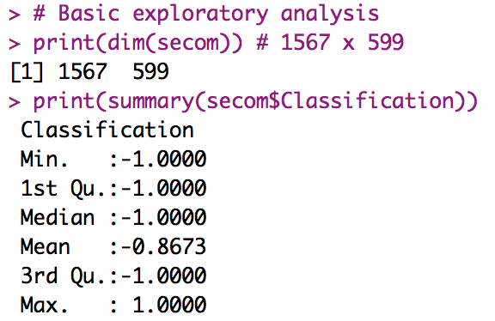
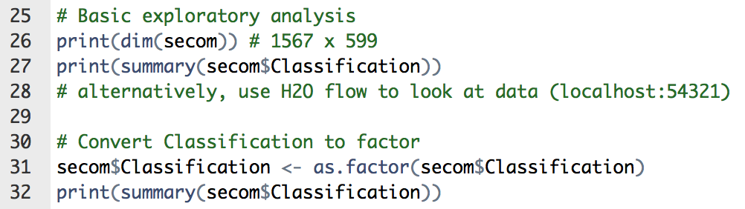
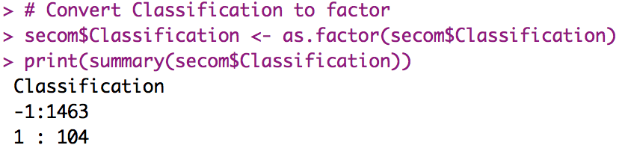
step_02_exploratory_analysis.R
Basic exploratory analysis
Convert -1 and 1 to categorical value

Slide 21
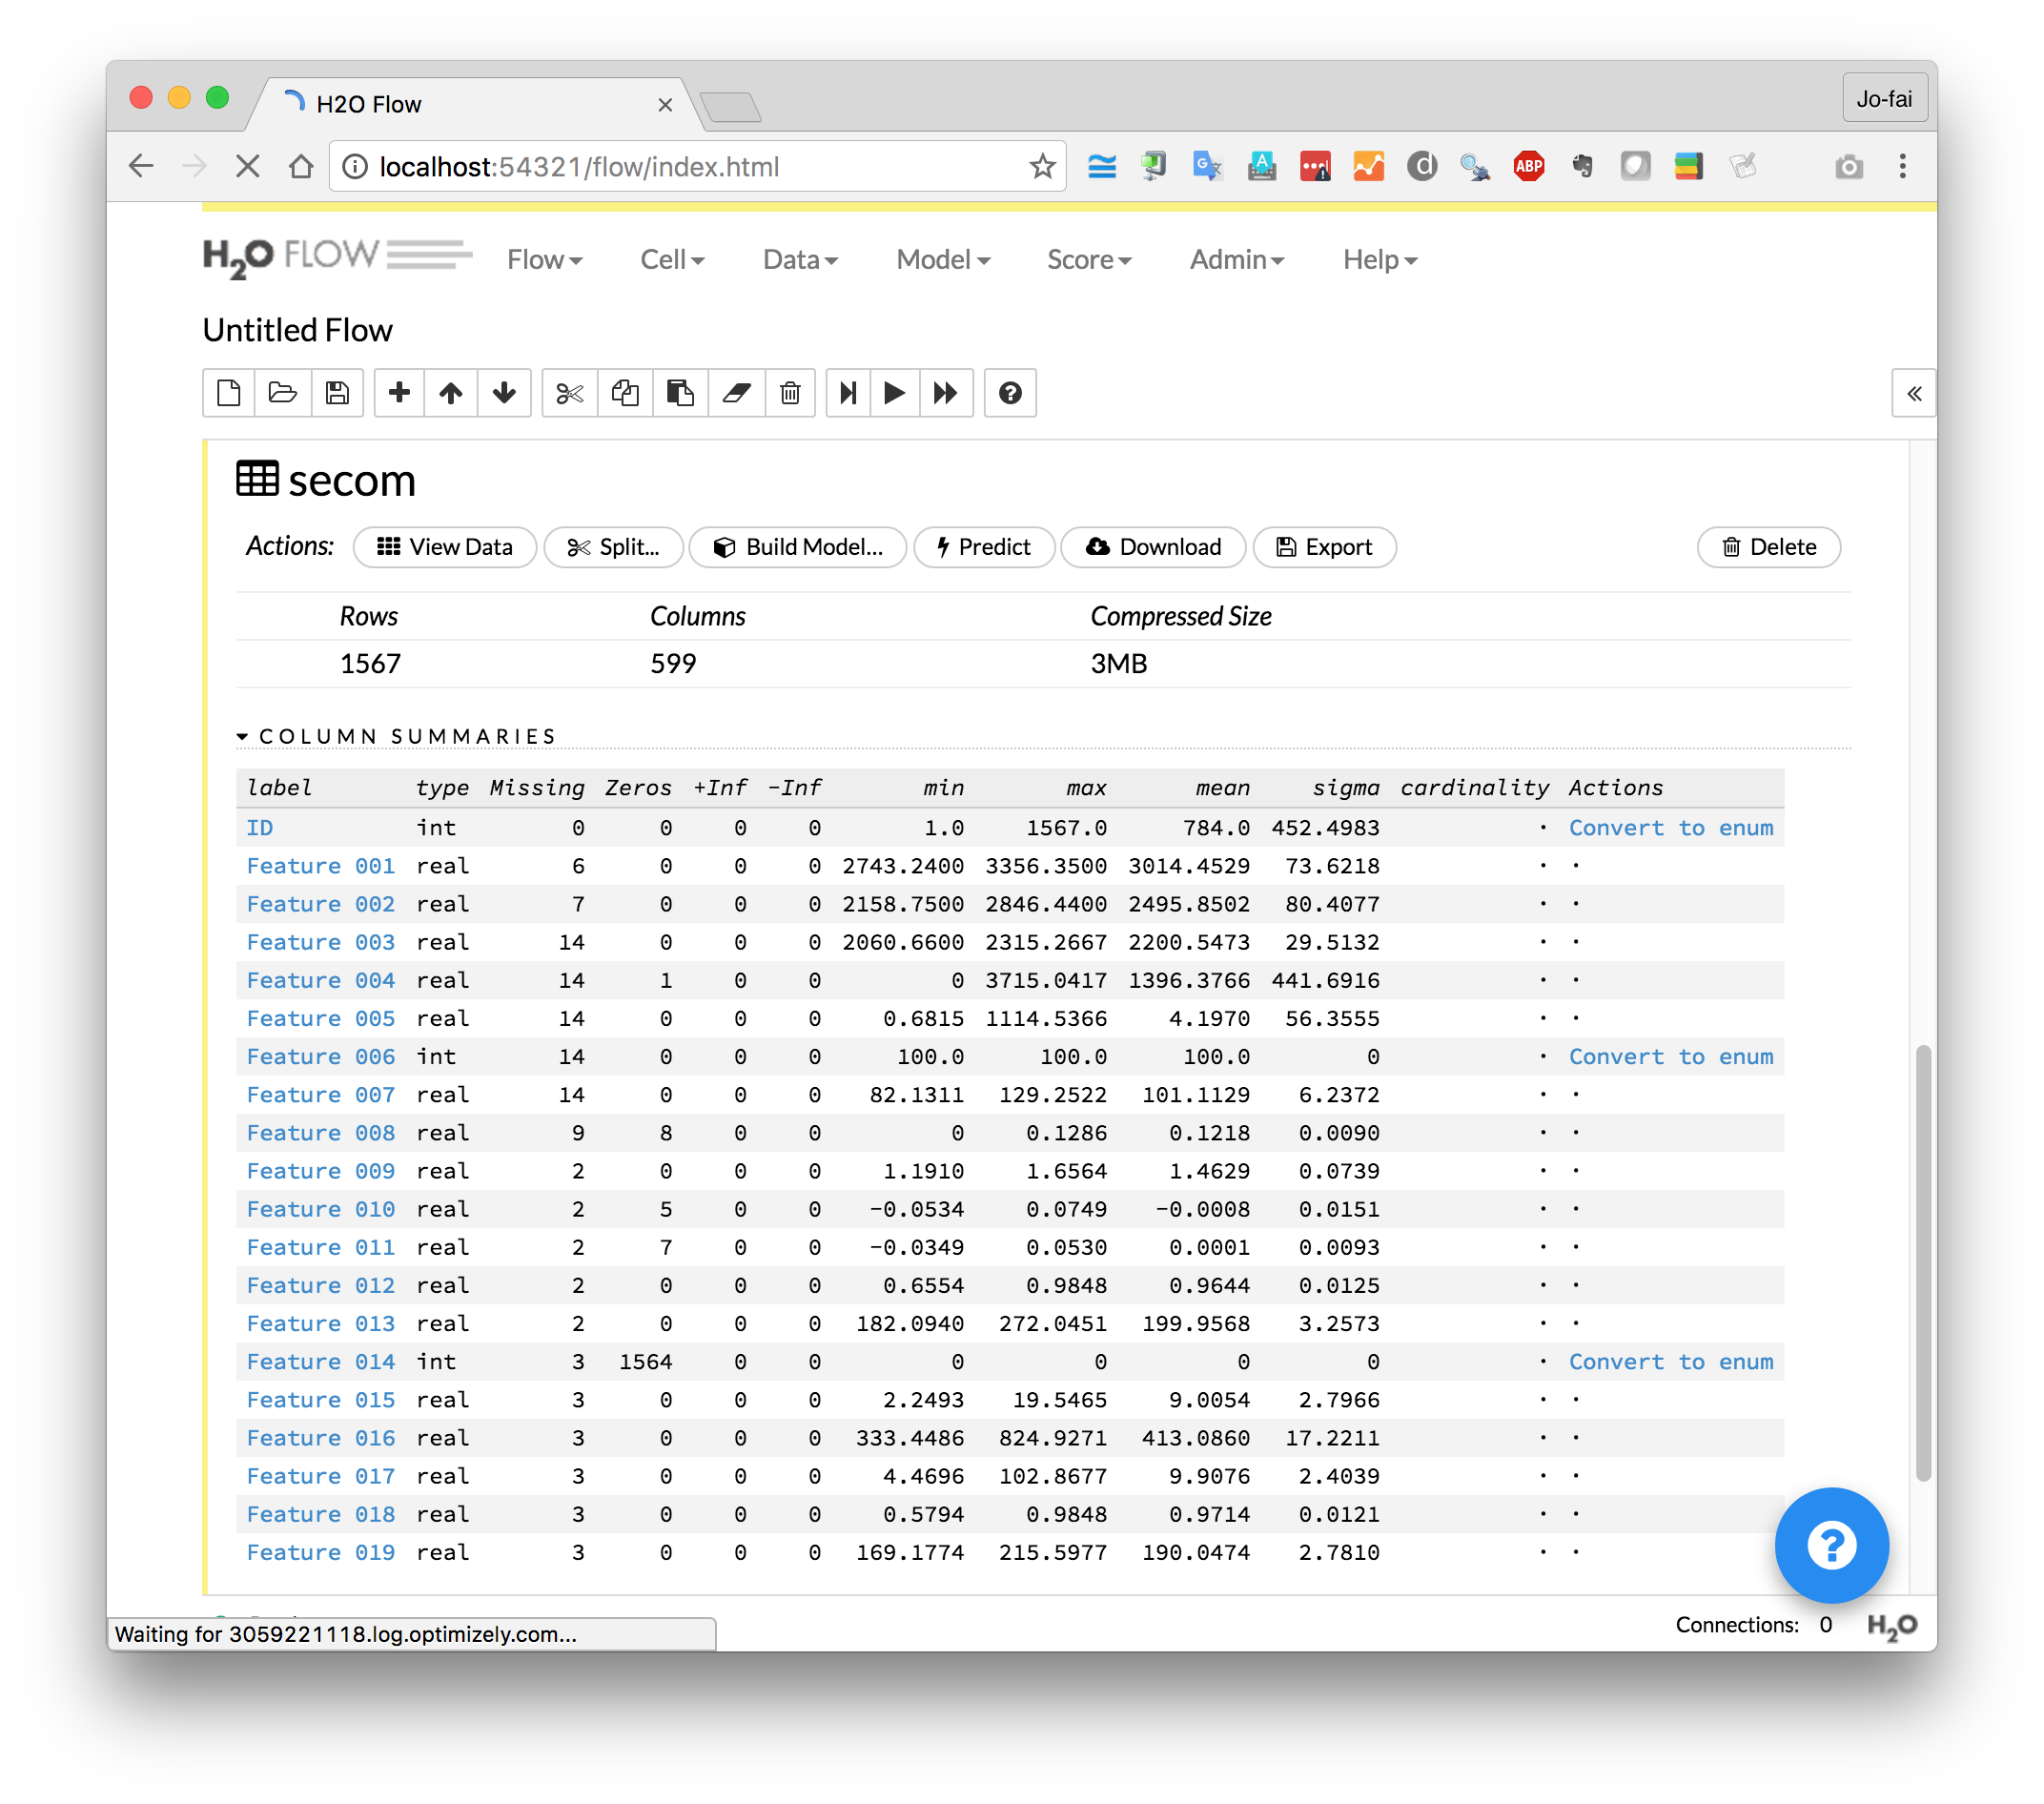
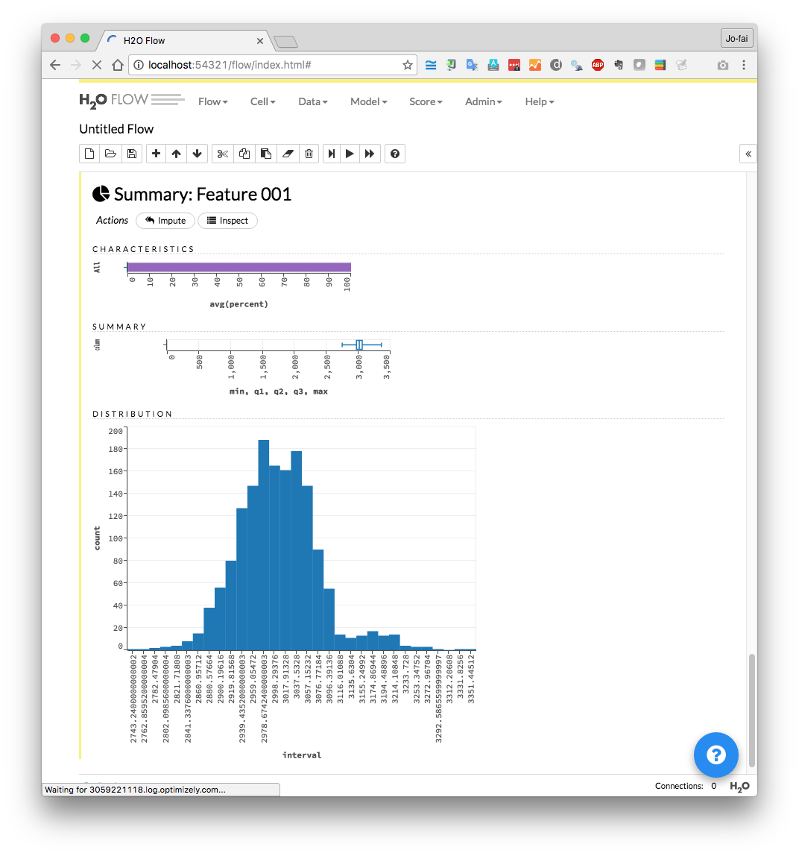
Use H2O Flow (localhost:54321)

Slide 22
Workshop #1
Use Case 1: Classification
Step 3: Building & Evaluating Models

Slide 23
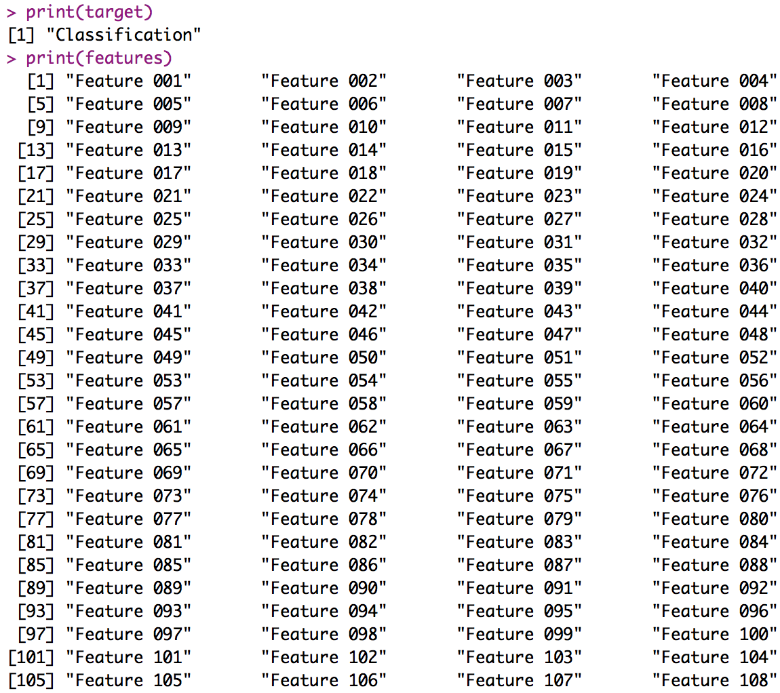
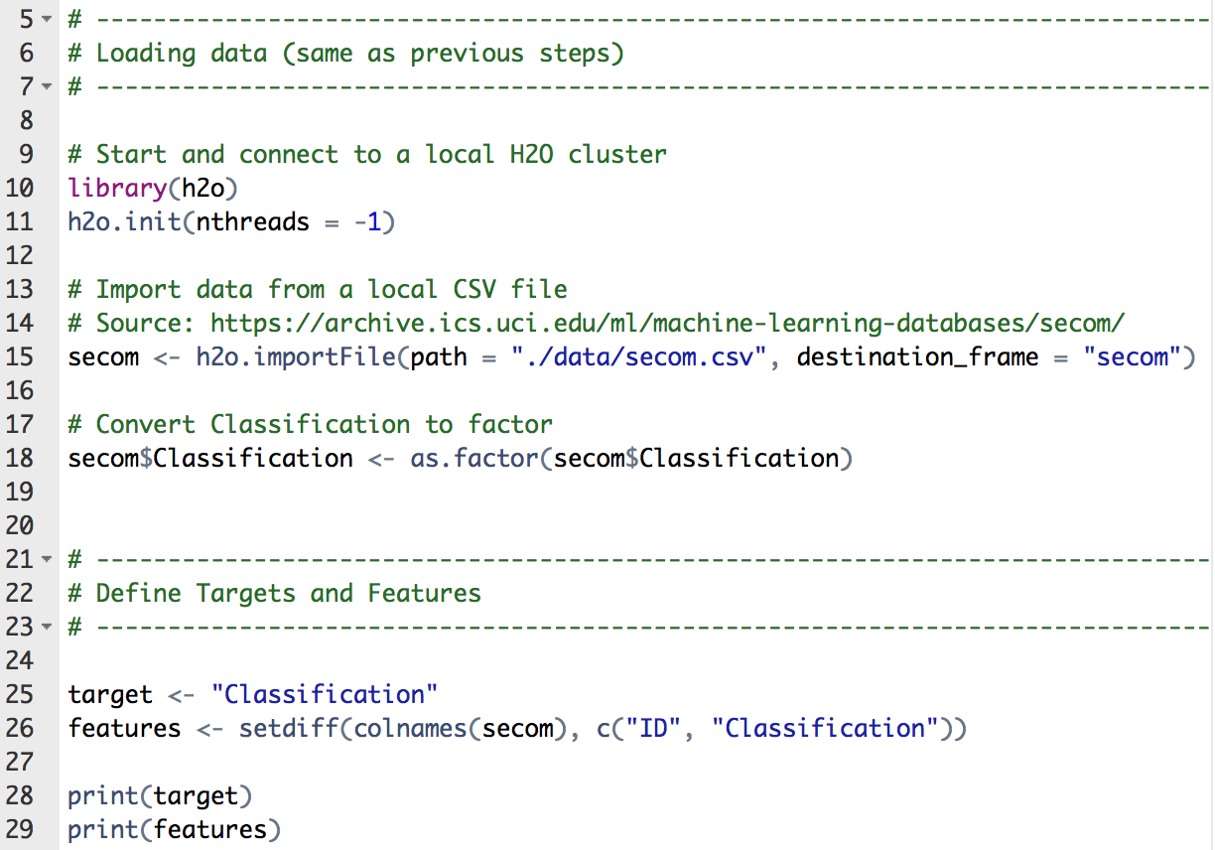
step_03_basic_models.R
Define features & target

Slide 24
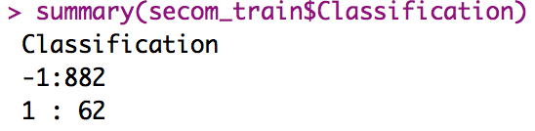
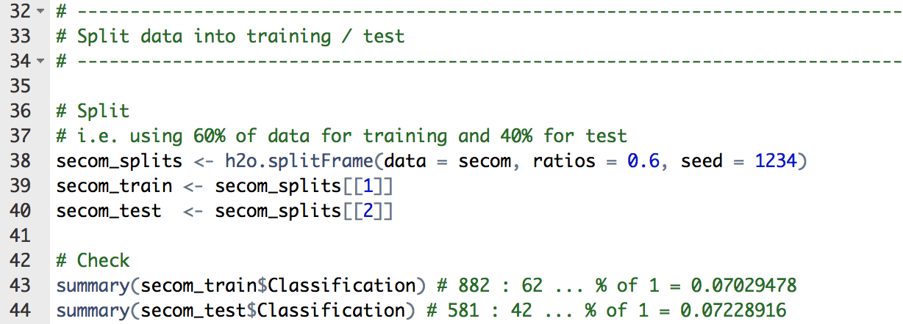
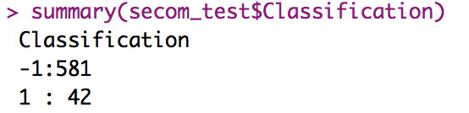
step_03_basic_models.R
Split data with a random seed
Classification 1 samples ≈ 7%

Slide 25
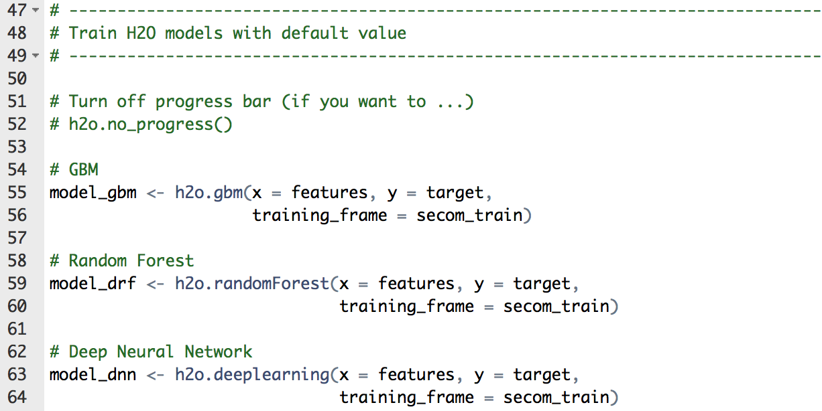
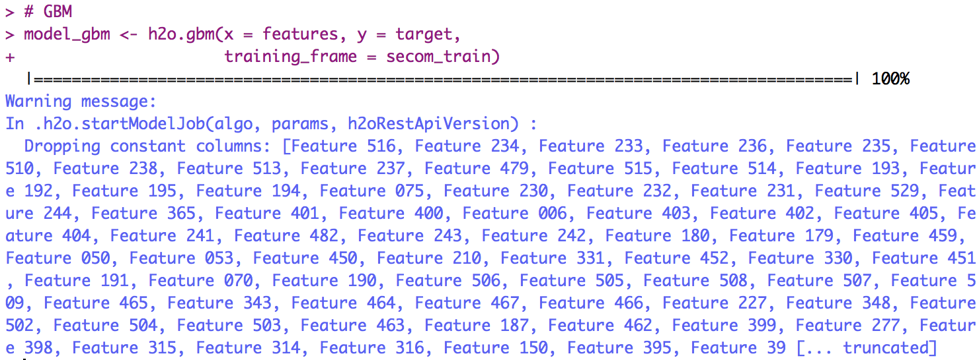
step_03_basic_models.R
Train H2O models with default values
H2O automatically ignores
Columns with constant values

Slide 26
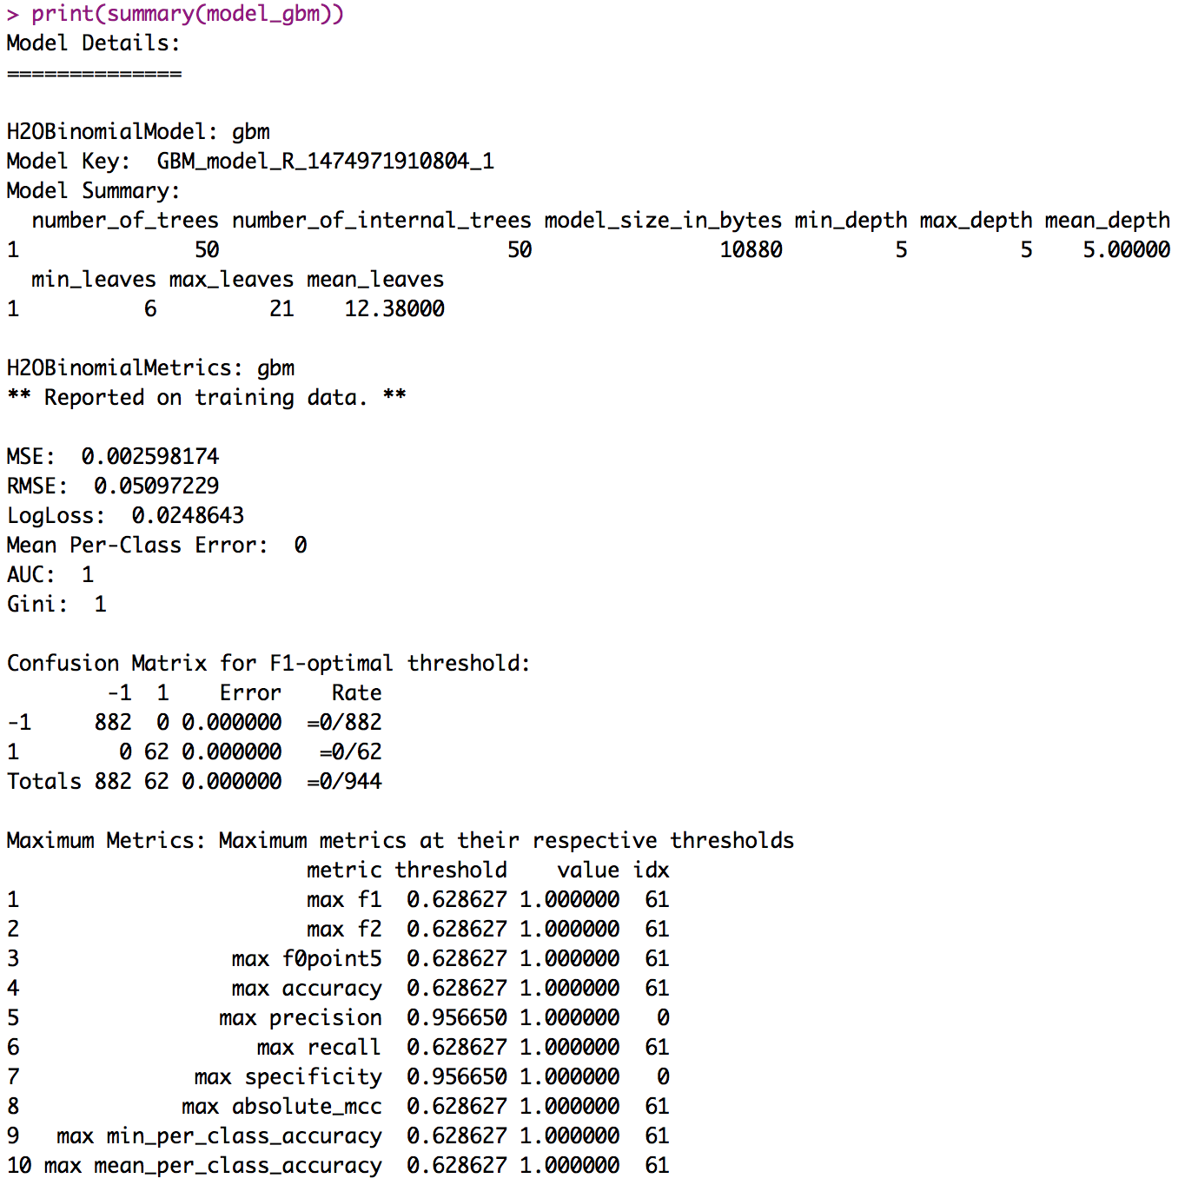
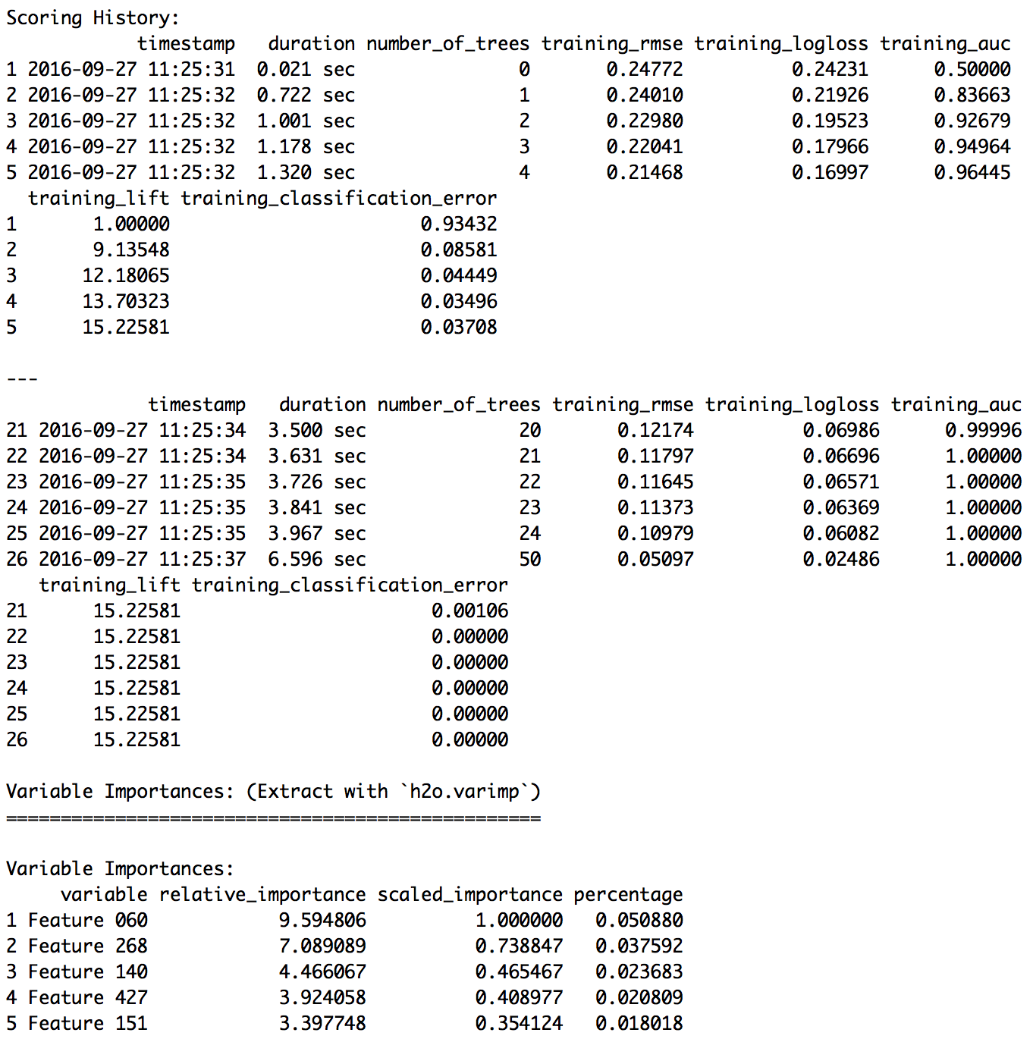
step_03_basic_models.R
summary(model_xxx)

Slide 27
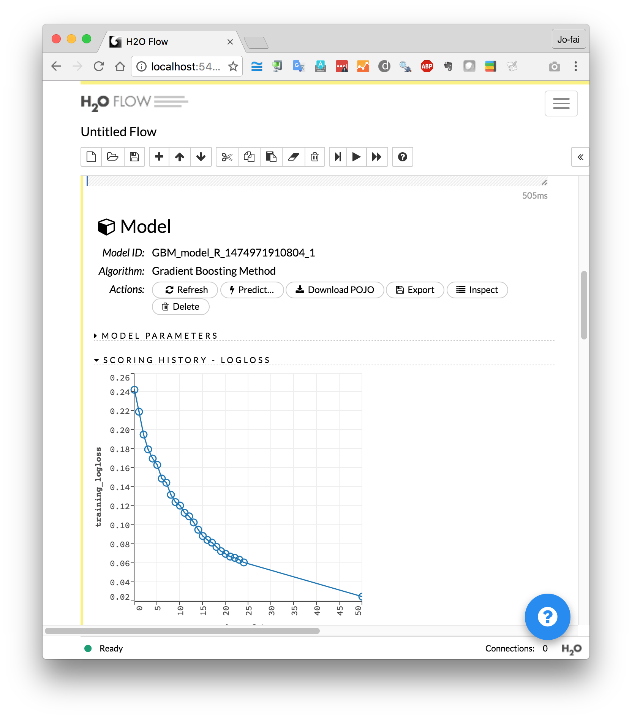
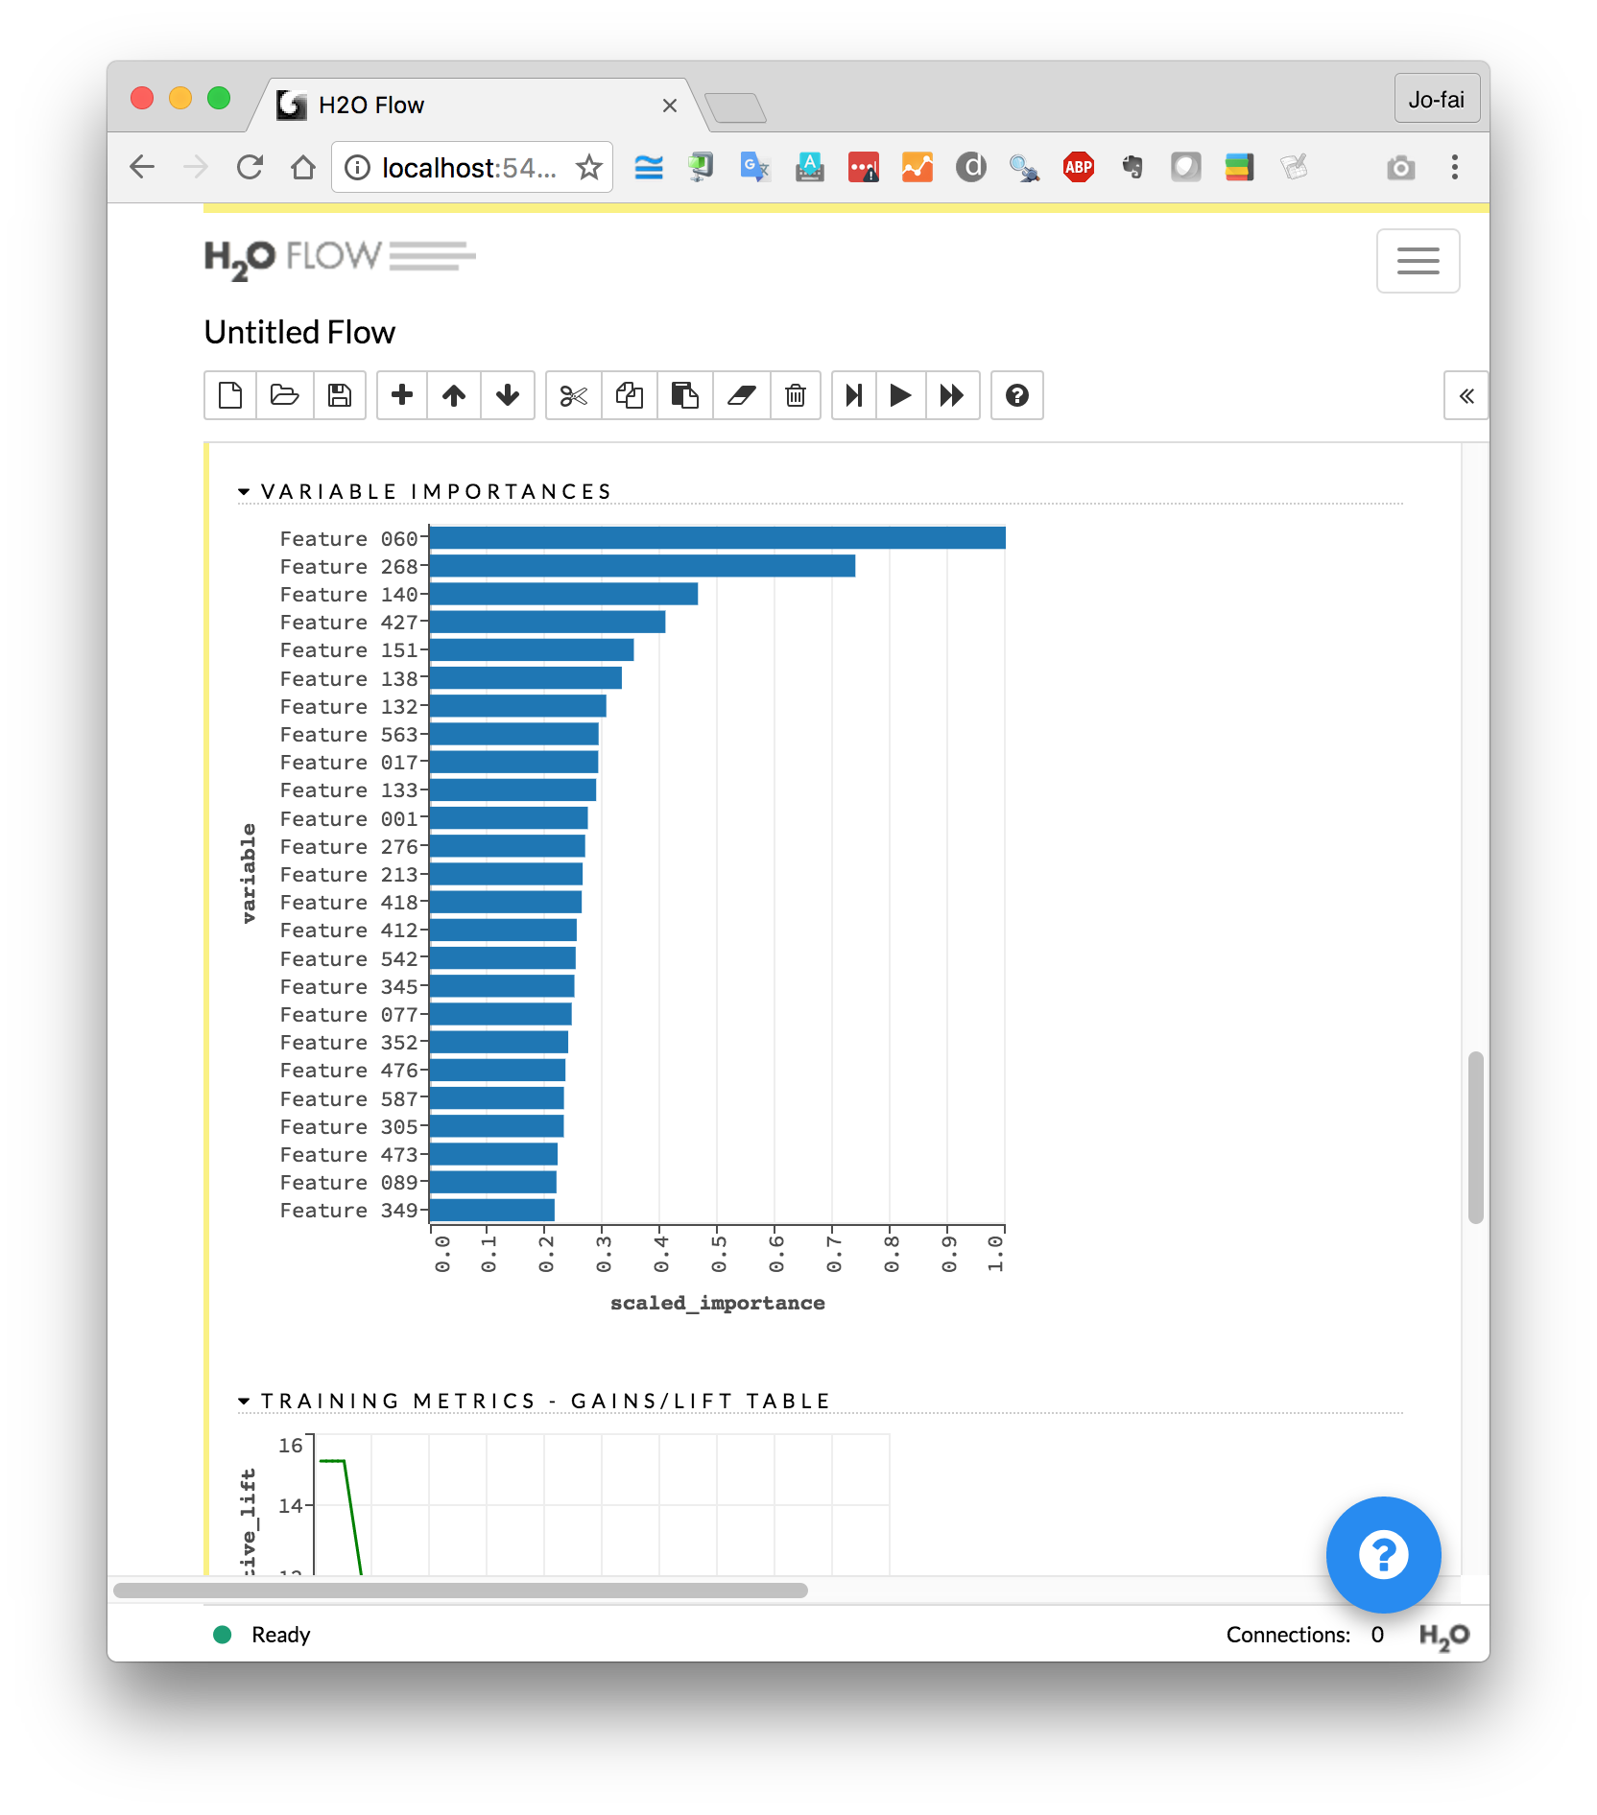
Use H2O Flow (localhost:54321)

Slide 28
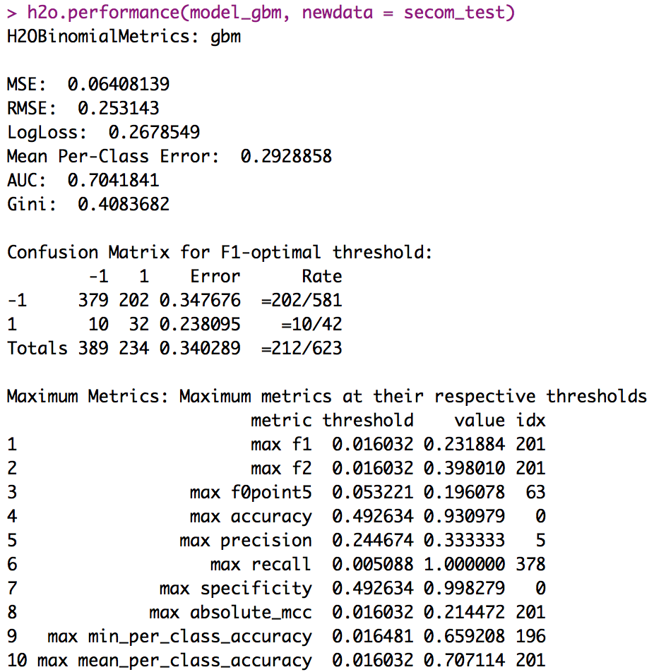
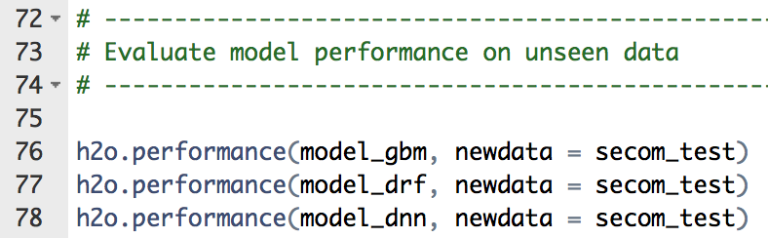
step_03_basic_models.R
Evaluate models with
test data

Slide 29
Workshop #1
Use Case 1: Classification
Step 4: Tuning Models

Slide 30
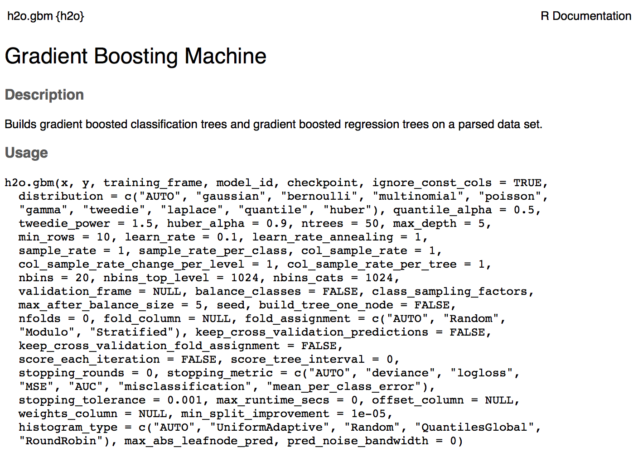
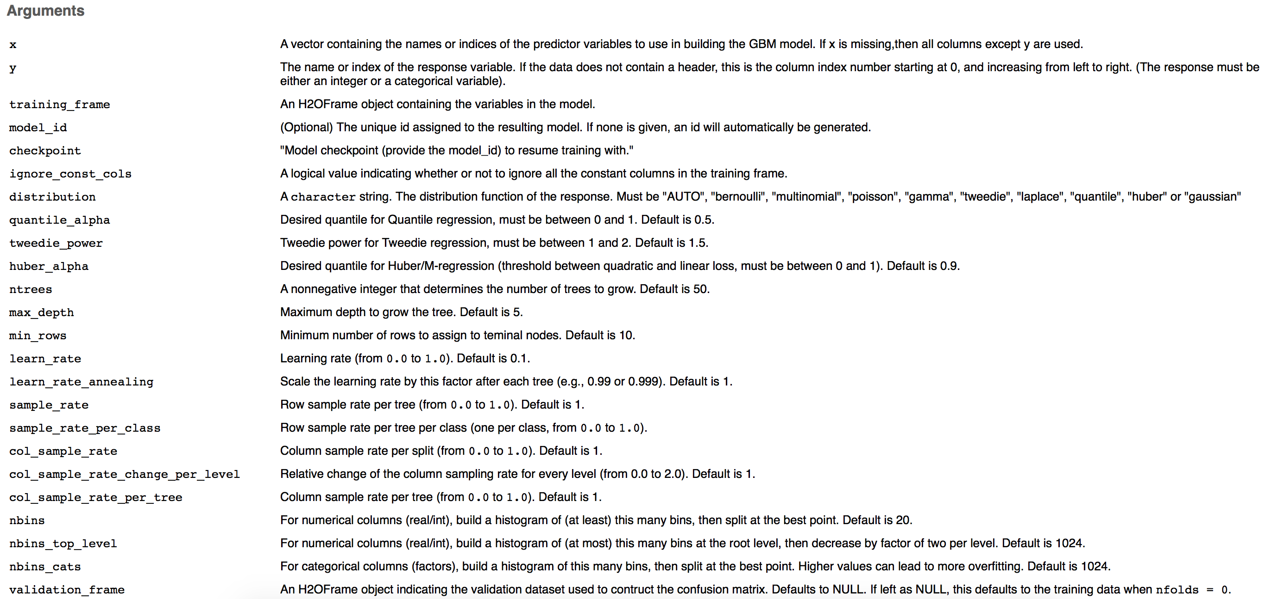
step_04_manual_tuning.R
?h2o.gbm ?h2o.deeplearning …

Slide 31
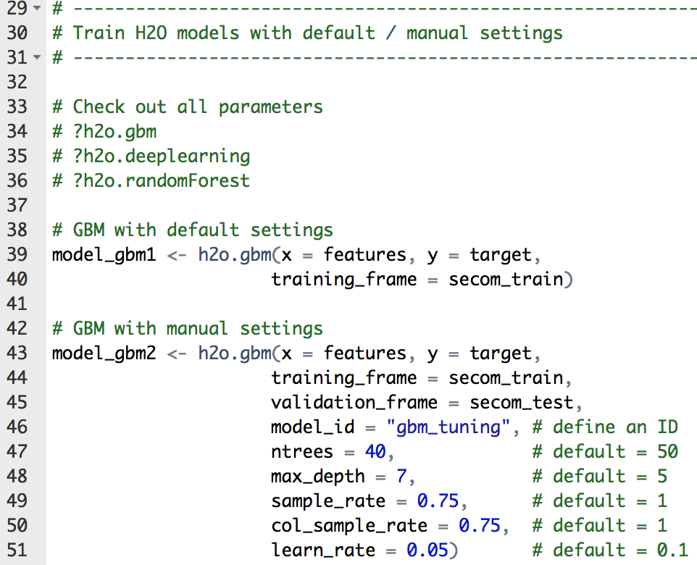
step_04_manual_tuning.R

Slide 32
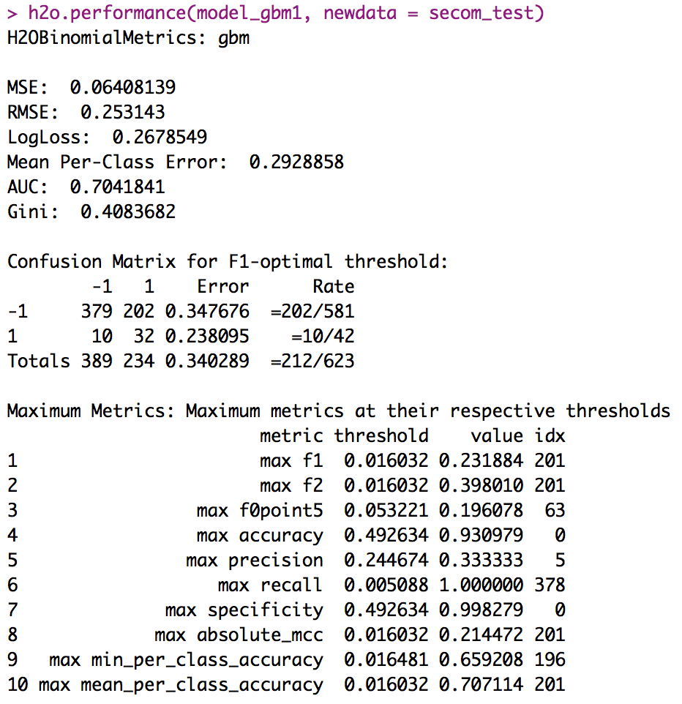
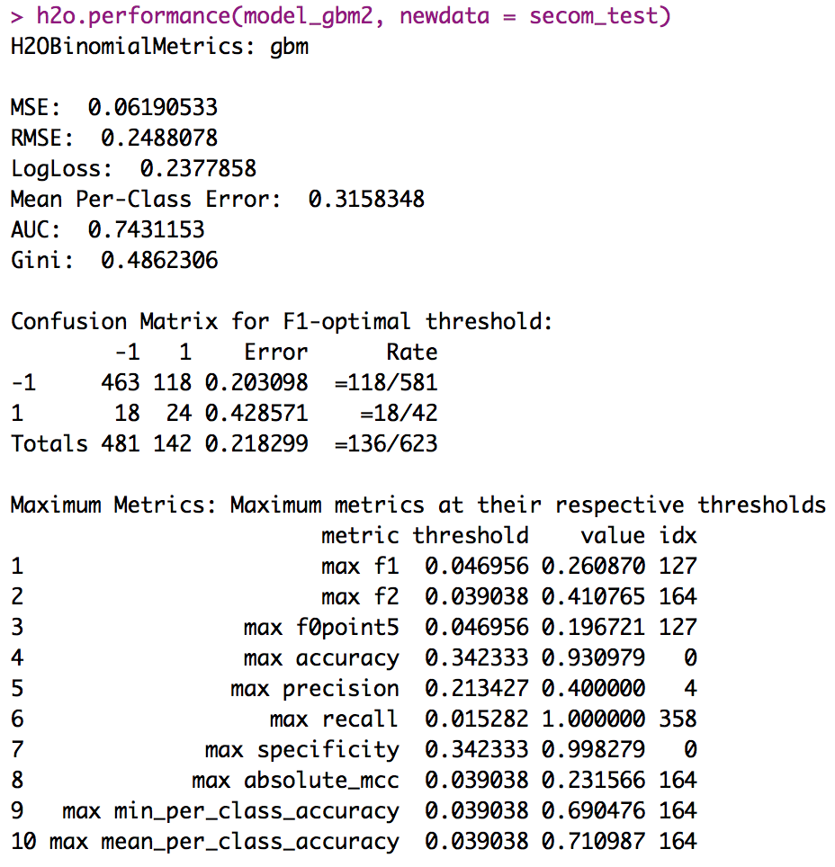
step_04_manual_tuning.R
Default
Manual settings
Better performance with manual settings

Slide 33
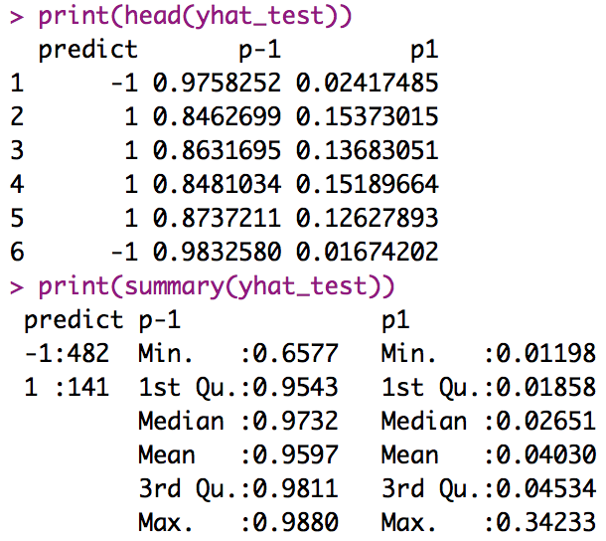
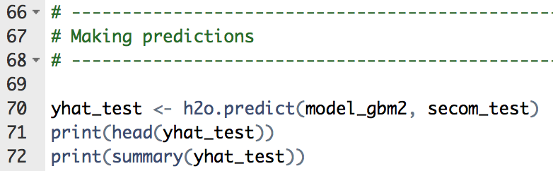
step_04_manual_tuning.R
Using the model for predictions

Slide 34
End of Workshop #1

Slide 35
Industrial IoT Data Science with H2O
Jo-fai (Joe) Chow
Data Scientist
joe@h2o.ai
@matlabulous
H2O Hands-on Workshop
La Fosse Associates
27th & 28th September, 2016

Slide 36
Agenda
Workshop #1
About H2O
Data Munging in H2O
Case 1 (Basics)
Classification
Importing data
Exploring data
Training models
Evaluating models
Tuning models (manual)
Workshop #2
Case 1 (Advanced)
Early stopping
Tuning models (auto)
Stacking models
Saving/loading models
Case 2
Anomaly detection
Other H2O features

Slide 37
Workshop #2
Use Case 1: Classification

Slide 38
Download Data & Code for Workshop
Please go to bit.ly/h2o_iot_workshop1

Slide 39
[RECAP] Data for Use Case 1: SECOM

Slide 40
Workshop #2
Use Case 1: Classification
Step 5: Tuning Models with Early Stopping

Slide 41
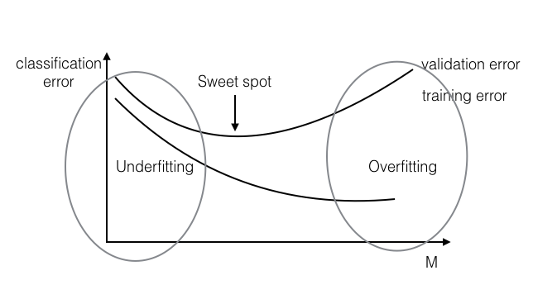
Underfitting and Overfitting

Slide 42
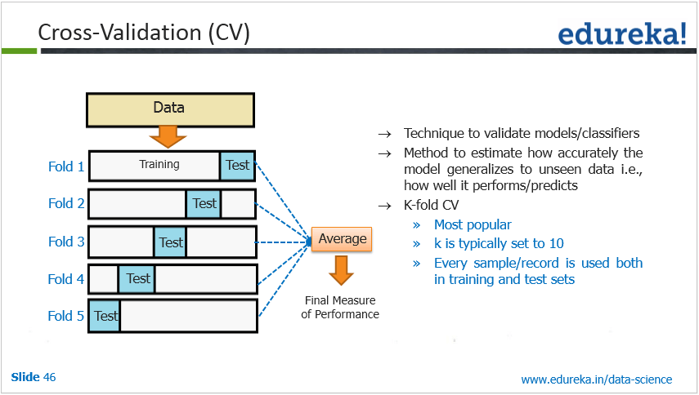
Cross Validation

Slide 43
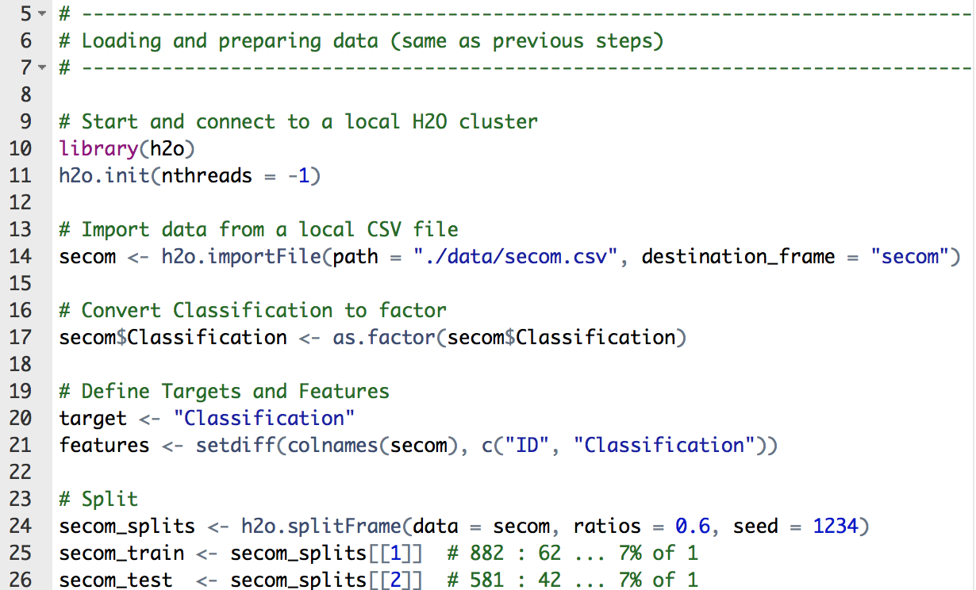
step_05_early_stopping.R
Workshop 1 Recap
Previous steps
Connect to H2O
Import data
Convert data type
Define target and features
Split data into training/test

Slide 44
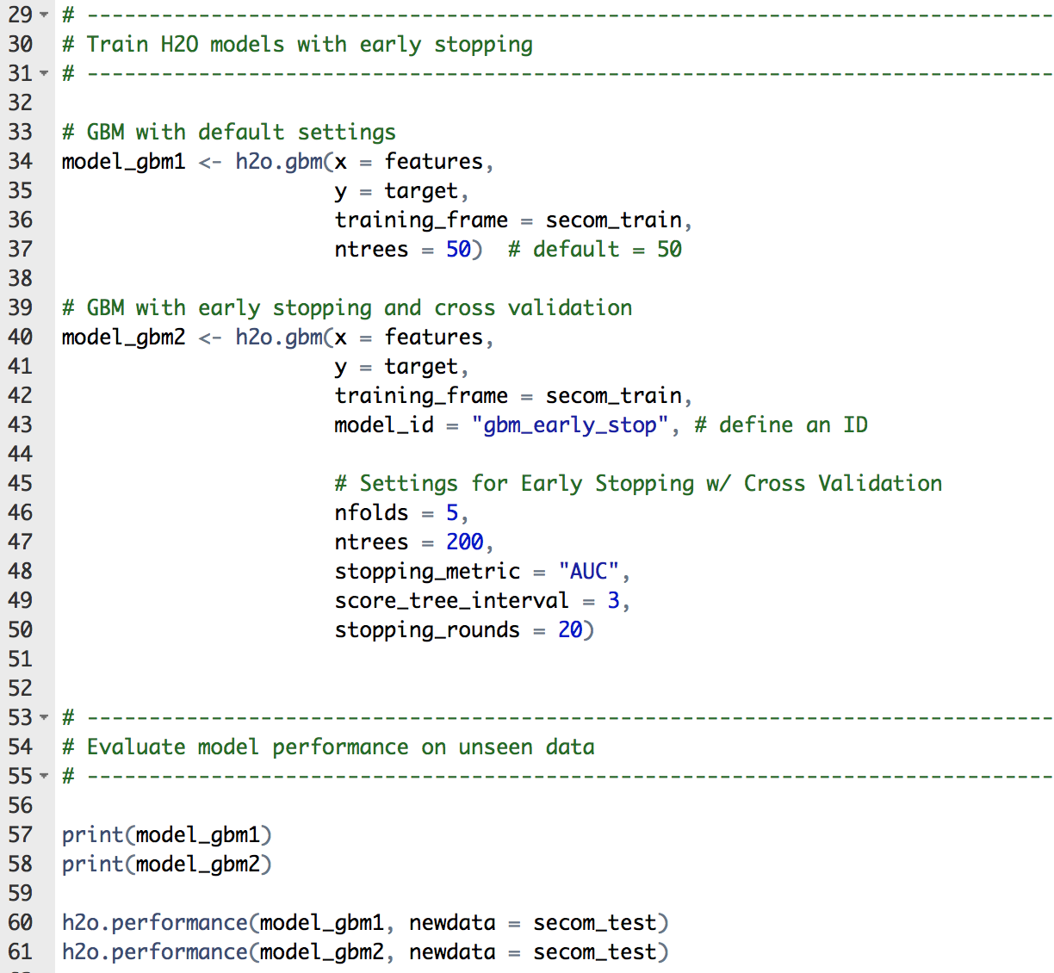
step_05_early_stopping.R
Two GBMs
Default settings
Early stopping with cross validation
Evaluate models

Slide 45
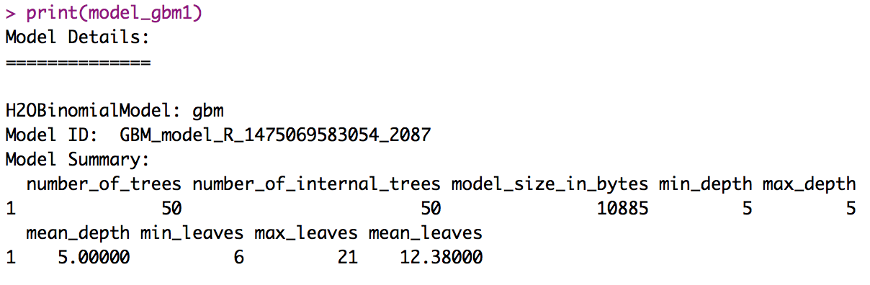
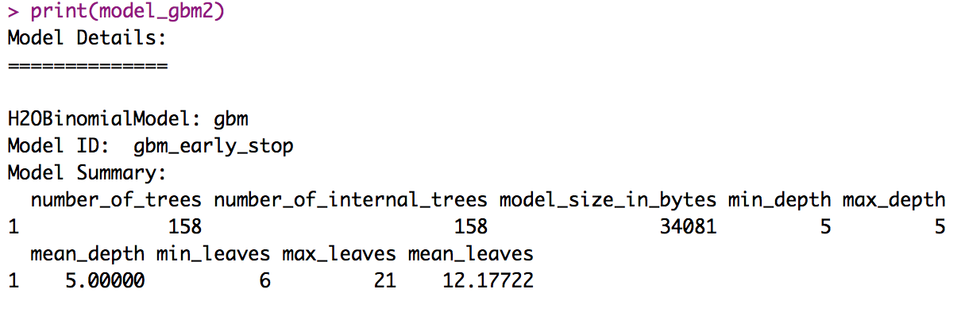
step_05_early_stopping.R
Default 50 trees
Stopped at 158th tree
with early stopping

Slide 46
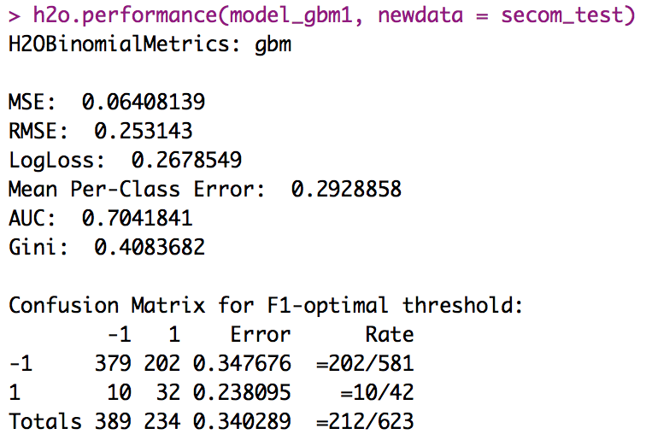
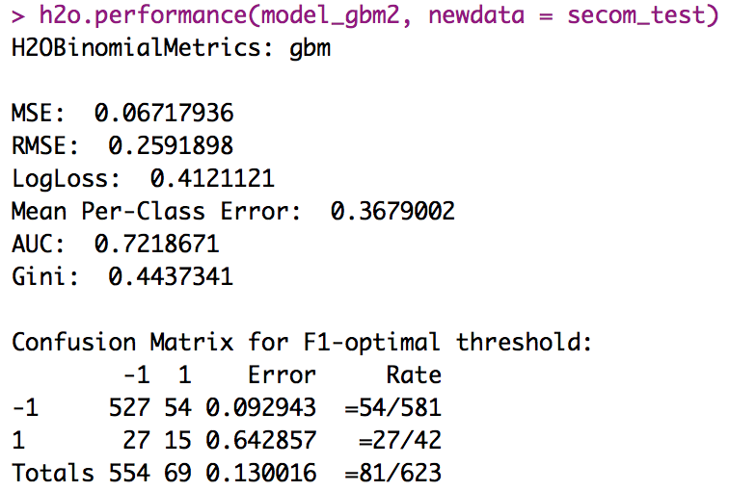
step_05_early_stopping.R
Default 50 trees
With early stopping
Better AUC (early stopping objective)

Slide 47
Workshop #2
Use Case 1: Classification
Step 6: Tuning Models with Grid Search

Slide 48
Full Grid Search
GBM Grid Example
Max depth
try 5, 6 and 7
Sample rate
try 0.8, 0.9 and 1
3 x 3 = 9 possible combinations
 | Max Depth | Sample Rate
Model 1 | 5 | 0.8
Model 2 | 5 | 0.9
Model 3 | 5 | 1.0
Model 4 | 6 | 0.8
Model 5 | 6 | 0.9
Model 6 | 6 | 1.0
Model 7 | 7 | 0.8
Model 8 | 7 | 0.9
Model 9 | 7 | 1.0

Slide 49
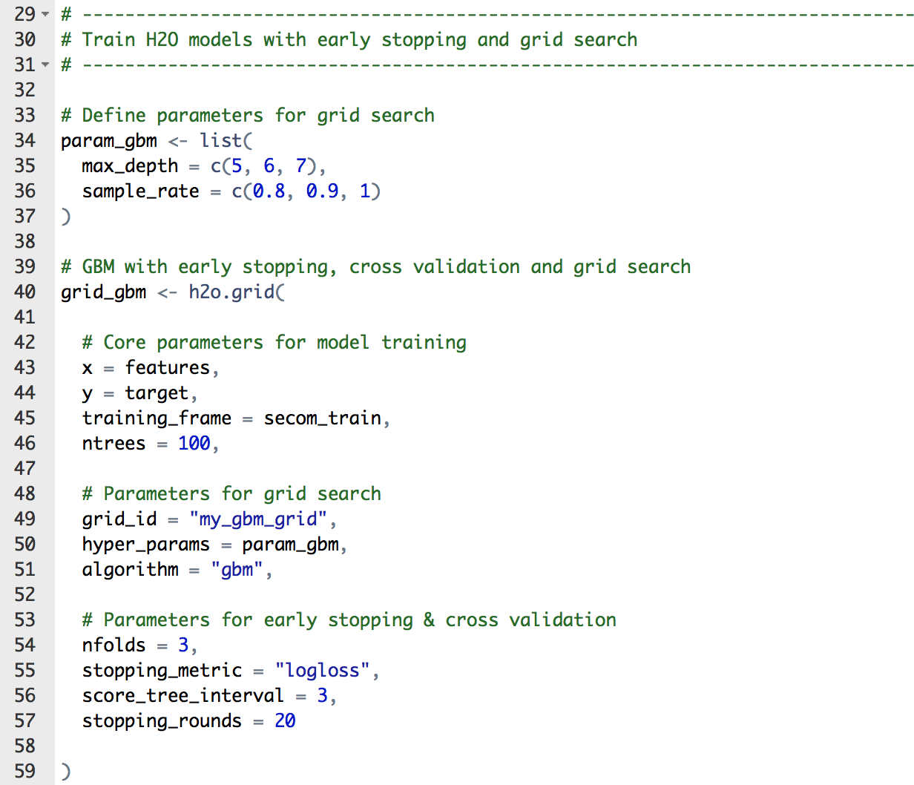
step_06_grid_search.R
Define parameters search space
Core settings
Grid search settings
Combined with early stopping and cross validation

Slide 50
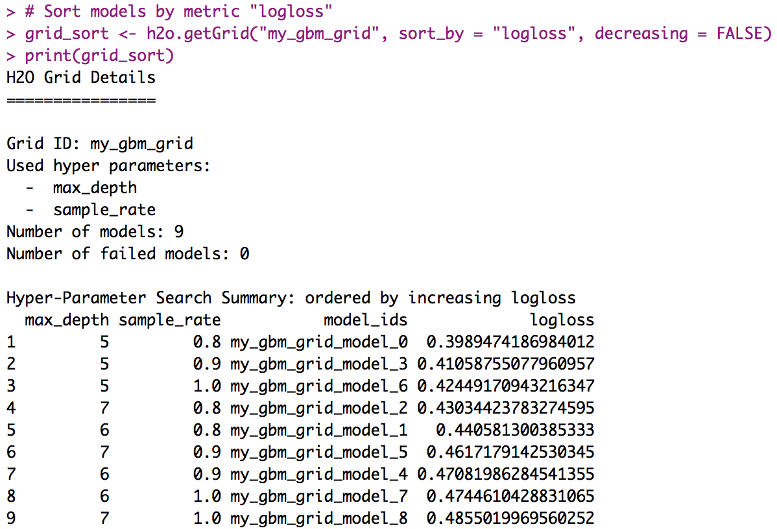
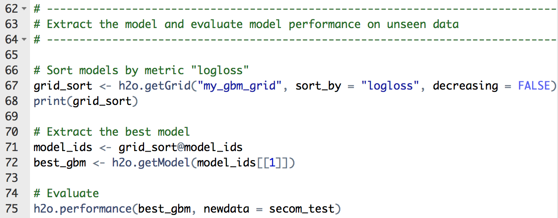
step_06_grid_search.R
Sort and extract models based on specific metric

Slide 51
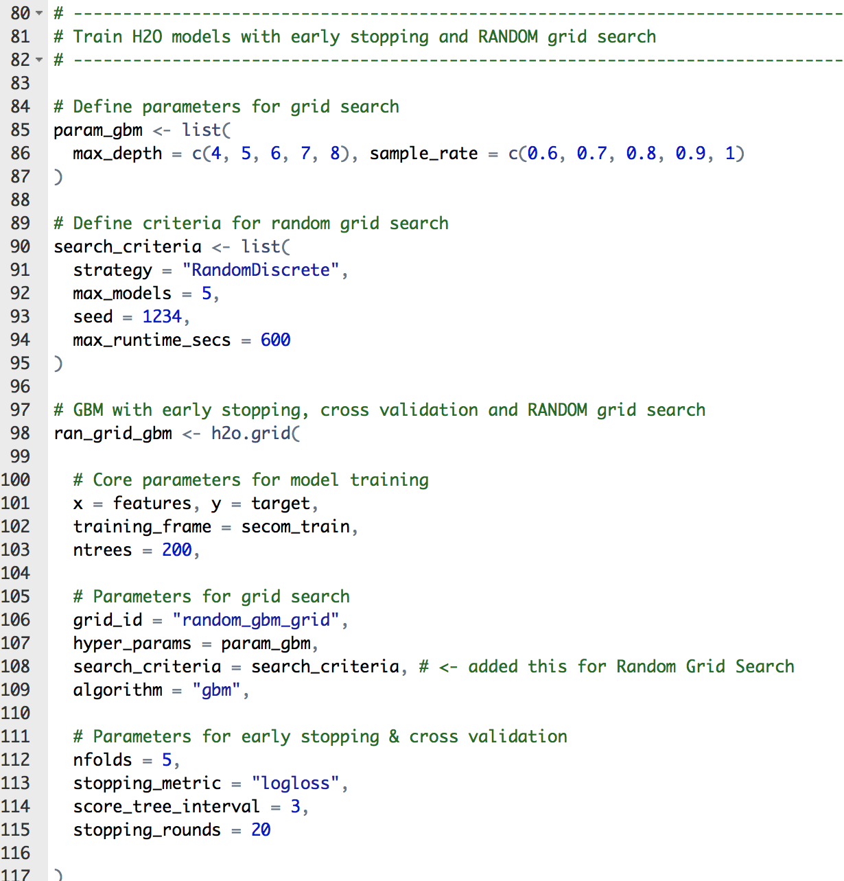

step_06_grid_search.R
Random (instead of full) Grid Search

Slide 52
Workshop #2
Use Case 1: Classification
Step 7: Stacking Models with h2oEnsemble

Slide 53

step_07_stacking_models.R
Four H2O models
Two GBM
Two DRF
Specific settings:
fold_assignment
Keep_cross_validation_predictions

Slide 54


step_07_stacking_models.R
Better AUC than any individual model

Slide 55
Workshop #2
Use Case 1: Classification
Step 8: Saving / Loading Models

Slide 56


Step_08_saving_loading.R

Slide 57
Workshop #2
Use Case 2: Anomaly Detection

Slide 58


use_case_2_anomaly_detection.R

Slide 59



use_case_2_anomaly_detection.R
Define your own cut-off point
Identify the outliers

Slide 60
Thanks!
Ajit and Sibanjan
La Fosse Associates
Slides & Code
bit.ly/ h2o_iot_workshop1
Contact
joe@h2o.ai
@matlabulous
github.com/woobe

